Slide 1
CARS24 PRICE INTELLIGENCE
Car Price Prediction
A machine learning project to estimate price from vehicle profile, usage, ownership and market attributes.
Mentor: Dilawar Basha
6,437 rows
R2 0.920
Rs. 71K
Cars24 listings analyzed
Final tuned XGBoost score
Final mean absolute error
Professional presentation | Cars24 data science project
01

Slide 2
TEAM
Project Team
Mentor
Team Members
Dilawar Basha
1
Kaushik Sonnakula
5
Thota Siddhika
2
Chandamala Gayathri
6
Siddarth Sharma
3
Chaitanya Suresh Gangarde
7
Archita Devishankar Dubey
4
Thiriveedhi Madhavi
Project deliverable: prediction model, evaluation workflow and Streamlit web app.
02

Slide 3
OBJECTIVE
The objective is to predict realistic car price.
Build a supervised regression model for Cars24 listing prices.
Use vehicle profile, usage and market signals to estimate price.
Compare multiple algorithms before selecting the final model.
Deploy the best model through a simple prediction app.
Target
Resale price
Output
Estimated selling price
Use Case
Quick valuation support
03

Slide 4
DATASET
The dataset combines vehicle profile, usage and marketplace information.
6,437
19
6,403
Rows before cleaning
Raw columns
Rows after outlier treatment
Target variable: listing price
Important inputs: make, model, city, year, fuel type, kilometers driven, owner number, transmission and body type
Dataset source file: cars24_data.csv
04

Slide 5
DATA QUALITY
Data cleaning removed noise while preserving almost all usable records.
376
375
34
15
Missing transmission values filled
Missing body-type values filled
Extreme outlier rows removed
Duplicate rows detected
Conservative outlier treatment kept 6,403 rows for modeling.
Price cap: Rs. 19.99 lakh; kilometer cap: 176K km.
High-cardinality and non-predictive columns were removed before modeling.
05

Slide 6
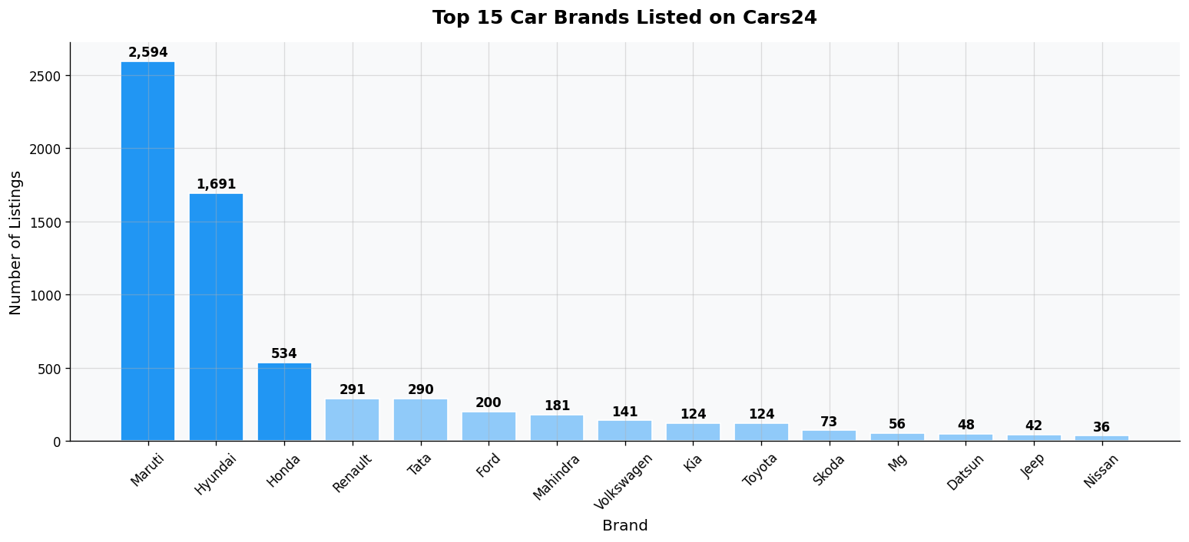
EDA
The market is budget-segment heavy, led by Maruti and Hyundai.
Inference
Maruti and Hyundai together contribute 66.6% of listings. This means the model must handle common mass-market cars very well, not only premium vehicles.
07

Slide 7
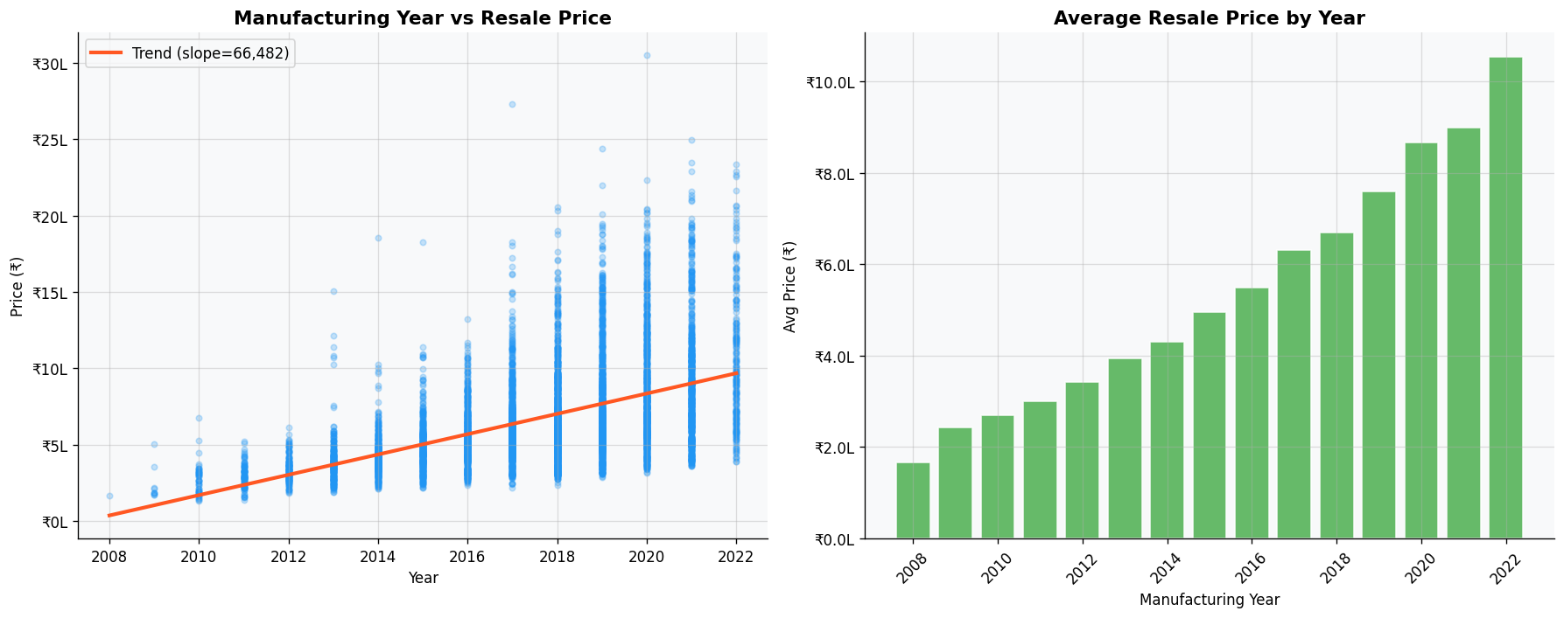
EDA
Newer manufacturing years strongly increase resale value.
Inference
The year-price correlation is 0.512. Newer cars retain higher resale value, making manufacturing year and derived car age central predictors.
08

Slide 8
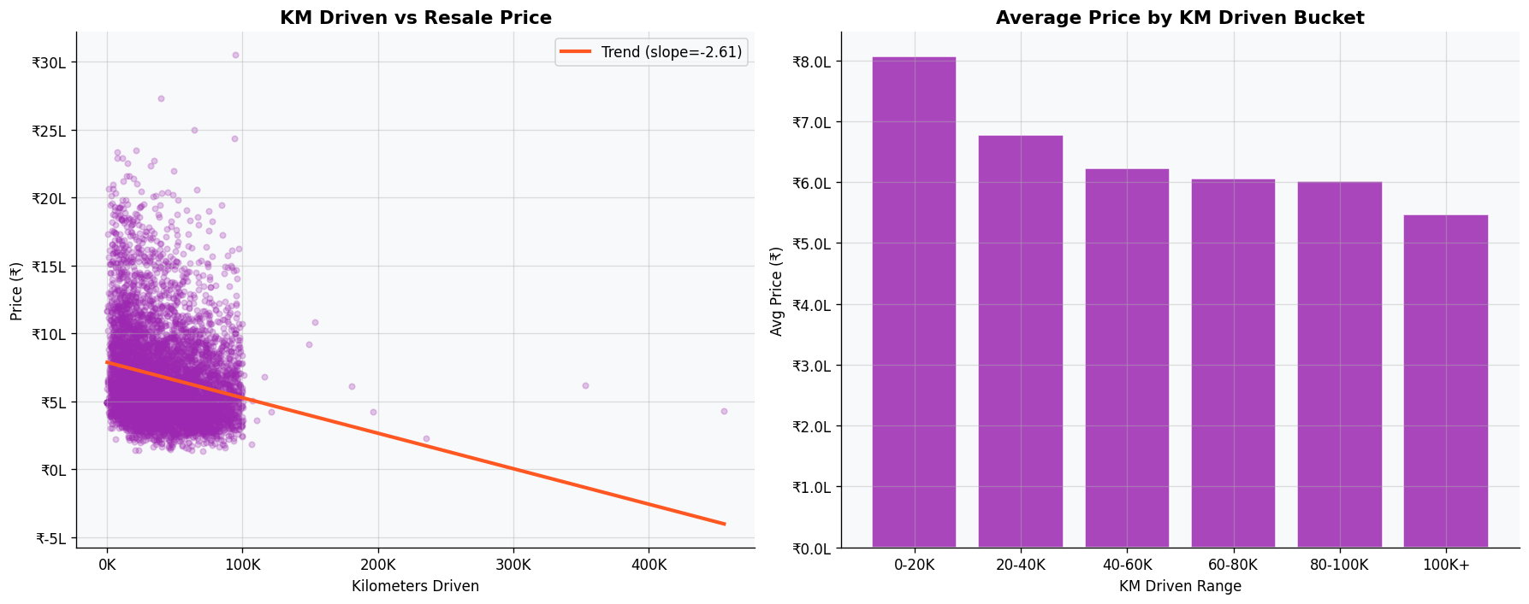
EDA
Mileage has a visible depreciation effect, but it is not the only driver.
Inference
Kilometers driven has a negative correlation of -0.198 with price. The relationship is weaker than year because brand, model, fuel and transmission also influence valuation.
09

Slide 9
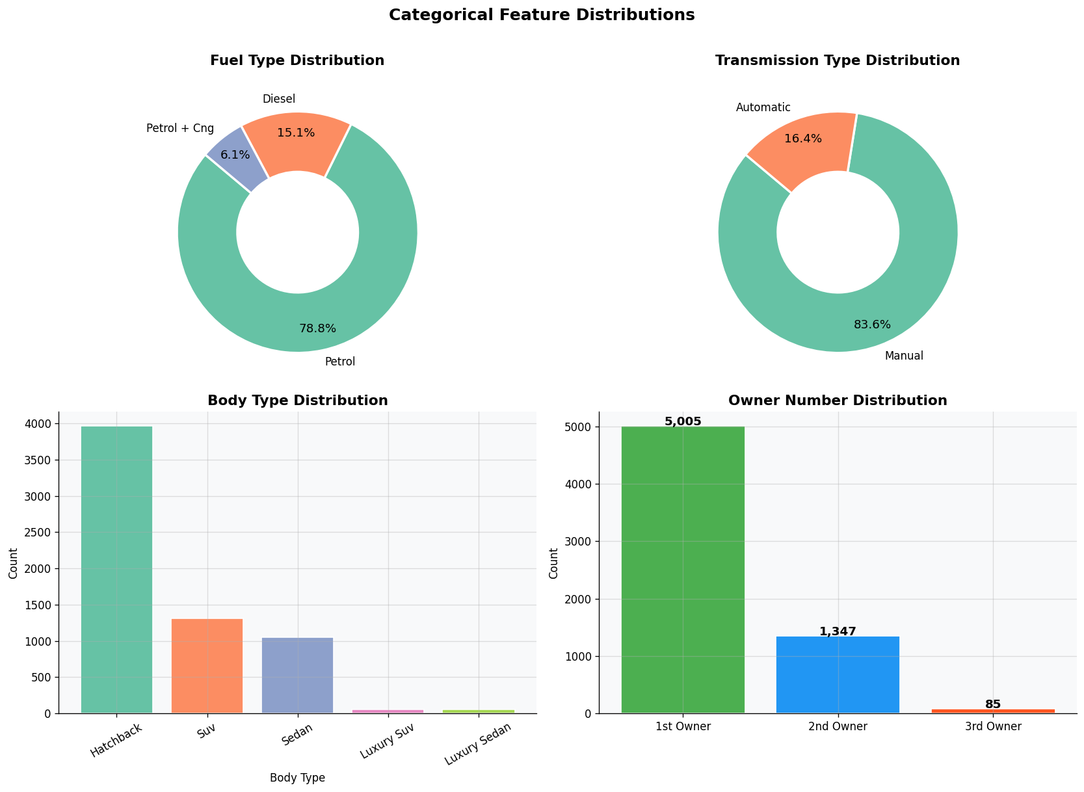
EDA
City and vehicle mix explain part of the observed pricing spread.
Inference
The data is concentrated in common body types and owner categories. Bangalore is the top city with 988 listings, so geography is included as a market signal.
10

Slide 10
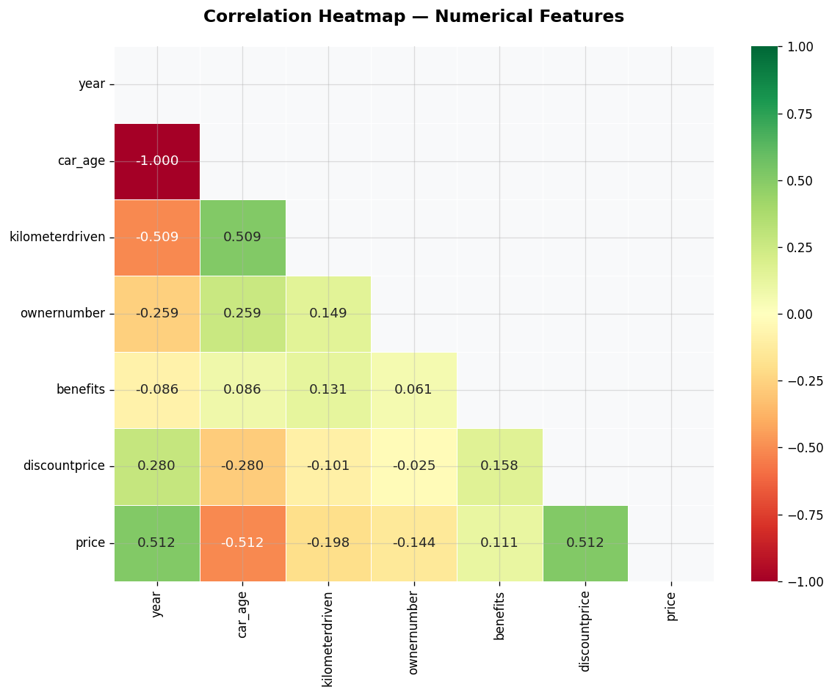
EDA CONCLUSIONS
The strongest EDA conclusion is that price is multi-factorial.
Newer vehicles sell at higher prices, confirming car age as a core feature.
Higher mileage lowers expected price, especially after usage-adjusted features are created.
Brand, model, body type and transmission create major price premiums.
A tree-based model is better suited than a simple linear model because interactions matter.
11

Slide 11
MODEL BUILDING
The modeling pipeline turned raw listings into prediction-ready signals.
Clean data
Engineer features
Train-test split
Encode categories
Compare models
The pipeline keeps the final app stable because the saved model and column order are used consistently during prediction.
12

Slide 12
MODEL BUILDING
Five regression approaches were tested before selecting the final model.
Linear Regression
0.793
Linear Regression created the baseline.
Decision Tree captured some nonlinear behavior but was weaker.
Random Forest improved stability.
XGBoost performed best before tuning.
Tuned XGBoost became the final model.
Decision Tree
0.757
Random Forest
0.847
XGBoost
0.861
Tuned XGBoost
0.920
13

Slide 13
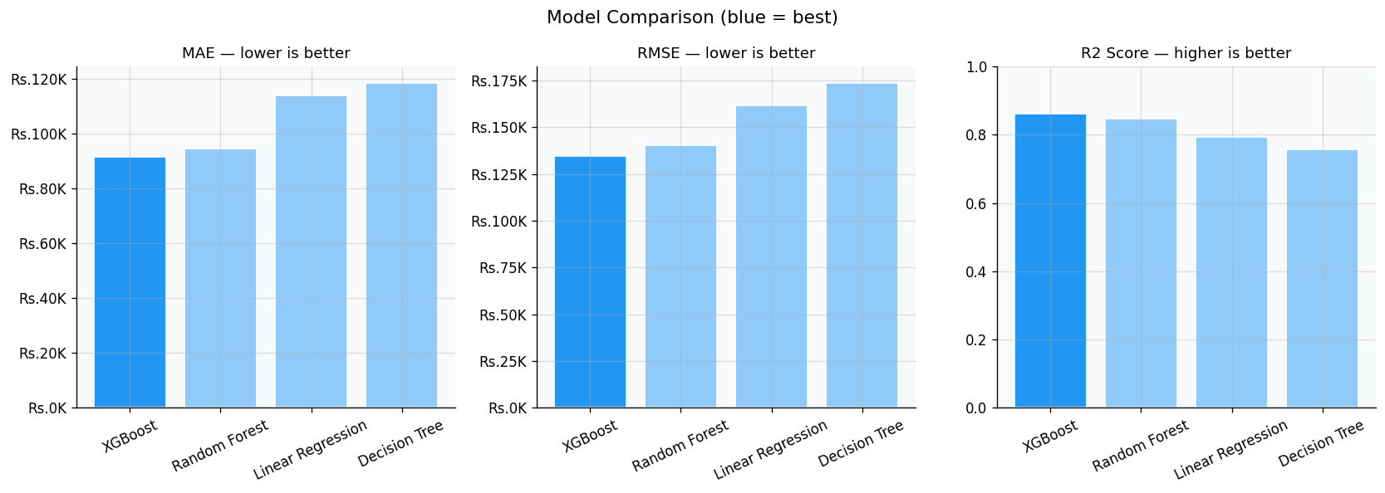
EVALUATION
XGBoost became the best candidate before final tuning.
Inference
Initial model comparison showed XGBoost leading with R2 0.8612 and lower error than Random Forest. This made it the best candidate for tuning and feature expansion.
14

Slide 14
MODEL IMPROVEMENT
The improvement strategy focused on missing valuation signals.
Model information was added because specific cars carry different resale value.
Usage intensity features separated normal driving from heavy use.
Ownership flags captured quality signals that affect buyer trust.
Hyperparameters were tuned for better accuracy and generalization.
Result
R2 increased from 0.8612 to 0.9200 after feature expansion and tuned XGBoost.
15

Slide 15
FINAL MODEL
Final model: tuned XGBoost with 99 prediction features.
0.9200
Rs. 71K
Rs. 114K
99
R-squared score
Mean absolute error
Root mean squared error
Final feature count
The final model explains most pricing variation on the test set.
Error is acceptable for a first valuation assistant, especially given used-car price variability.
The saved model is used by the app for real-time price prediction.
16

Slide 16
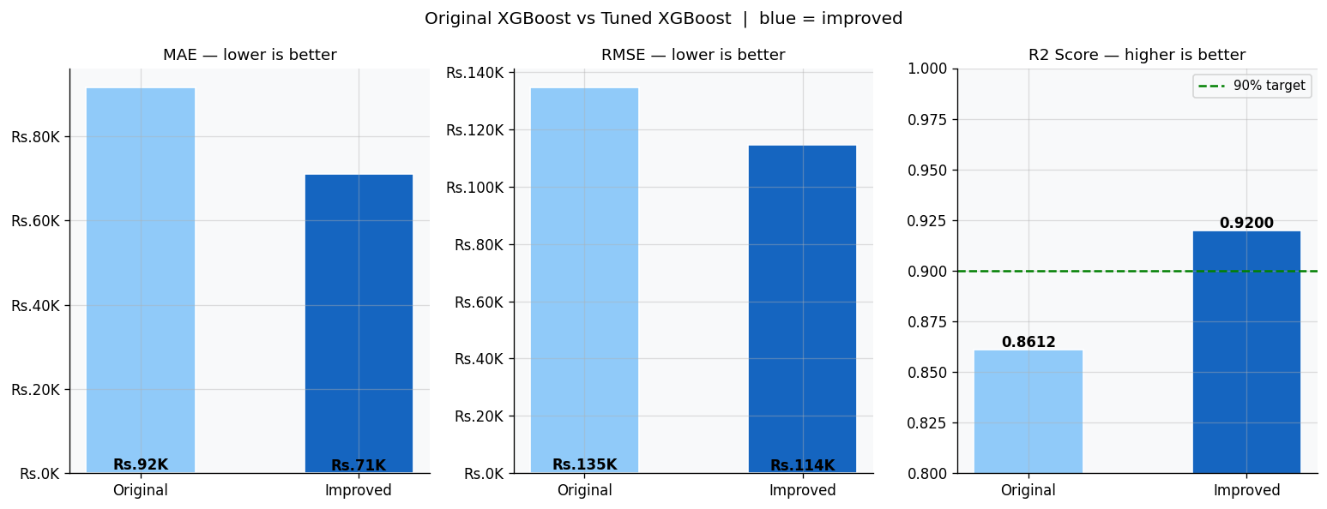
EVALUATION
Tuning reduced both average and larger prediction errors.
Inference
Compared with the original XGBoost model, the tuned version reduced MAE from Rs. 91,606 to Rs. 71,126 and increased R2 from 0.8612 to 0.9200.
17

Slide 17
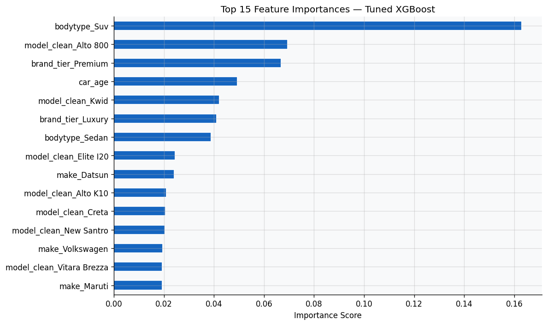
EVALUATION
The model relies most on body type, model identity and age.
Inference
SUV body type, specific model groups, brand tier and car age are among the strongest drivers. This confirms that valuation depends on both vehicle class and depreciation.
18

Slide 18
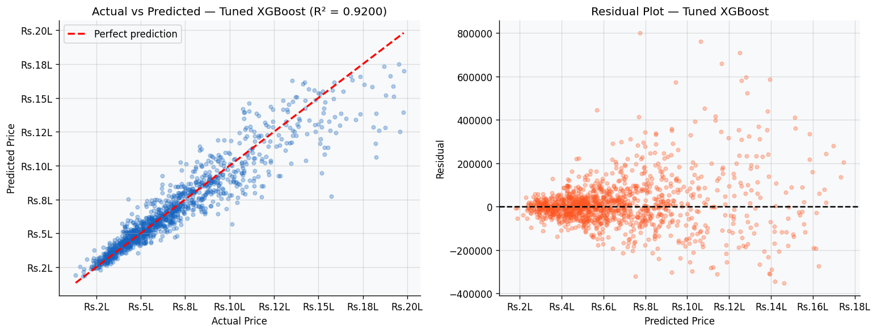
EVALUATION
Predictions generally track actual prices closely on the test data.
Inference
The actual-versus-predicted plot clusters around the ideal line. Remaining errors are expected where rare models, premium variants or unusual usage patterns are underrepresented.
19

Slide 19
FINAL INFERENCE
The final model is useful as a quick pricing assistant, not a replacement for inspection.
Best model: tuned XGBoost.
Most important pricing signals: vehicle type, model, brand tier, age and mileage intensity.
The app can provide a fast first estimate for users or analysts.
Physical condition, accident history and service records would further improve real-world precision.
Conclusion
A data-driven price estimate can reduce manual guesswork and make valuation more consistent.
20

Slide 20
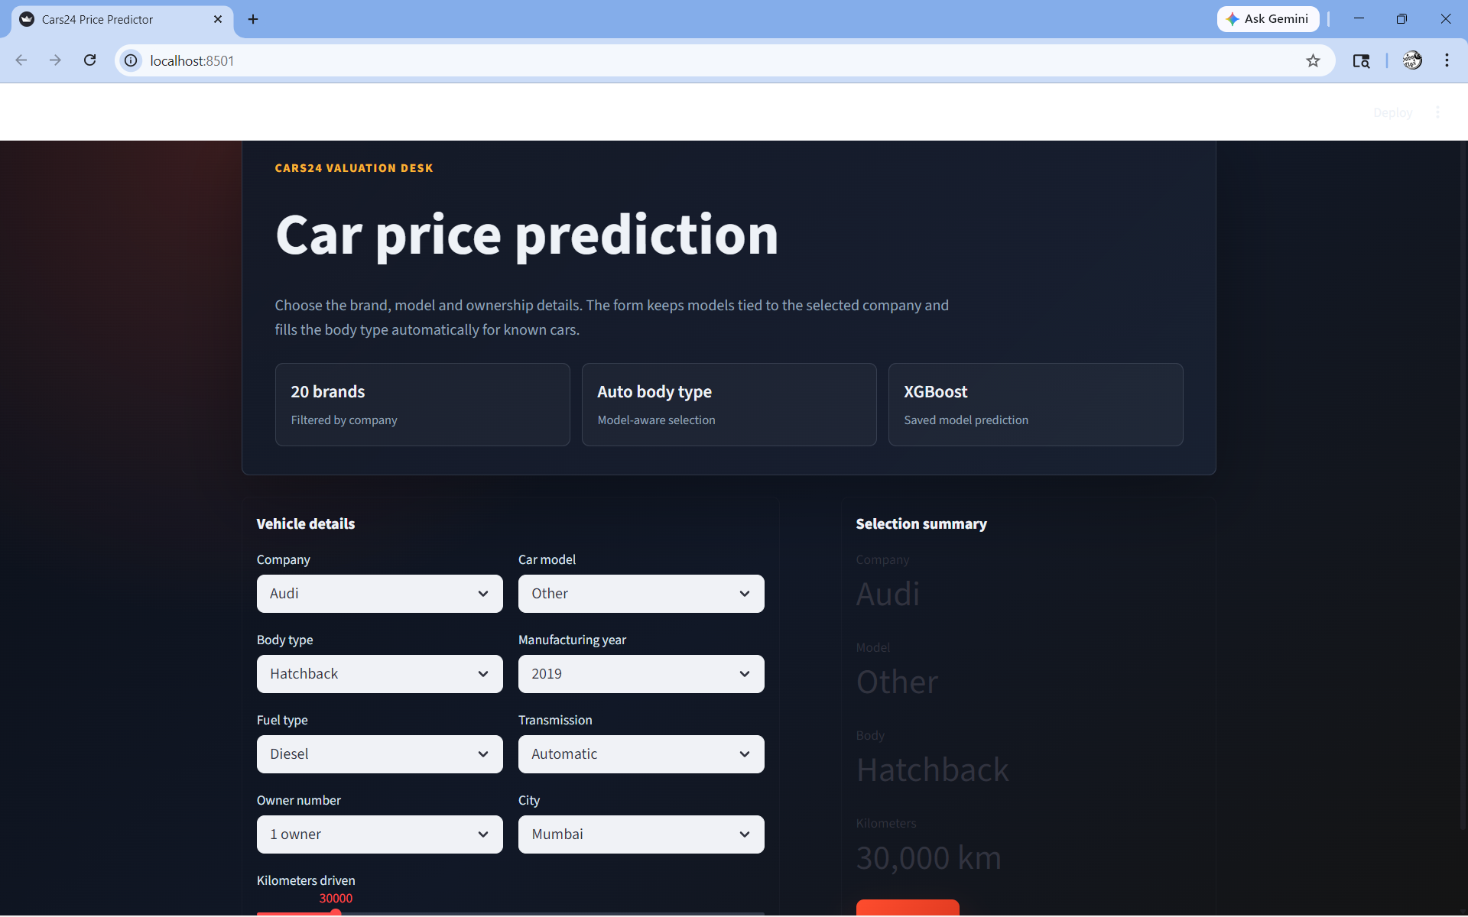
APP PAGE
The web app collects vehicle details in a clean guided form.
App inference
The form keeps the user flow simple by collecting brand, model, body type, year, fuel, city and mileage on one page before prediction.
User action: enter vehicle details, then click Predict Price.
21

Slide 21
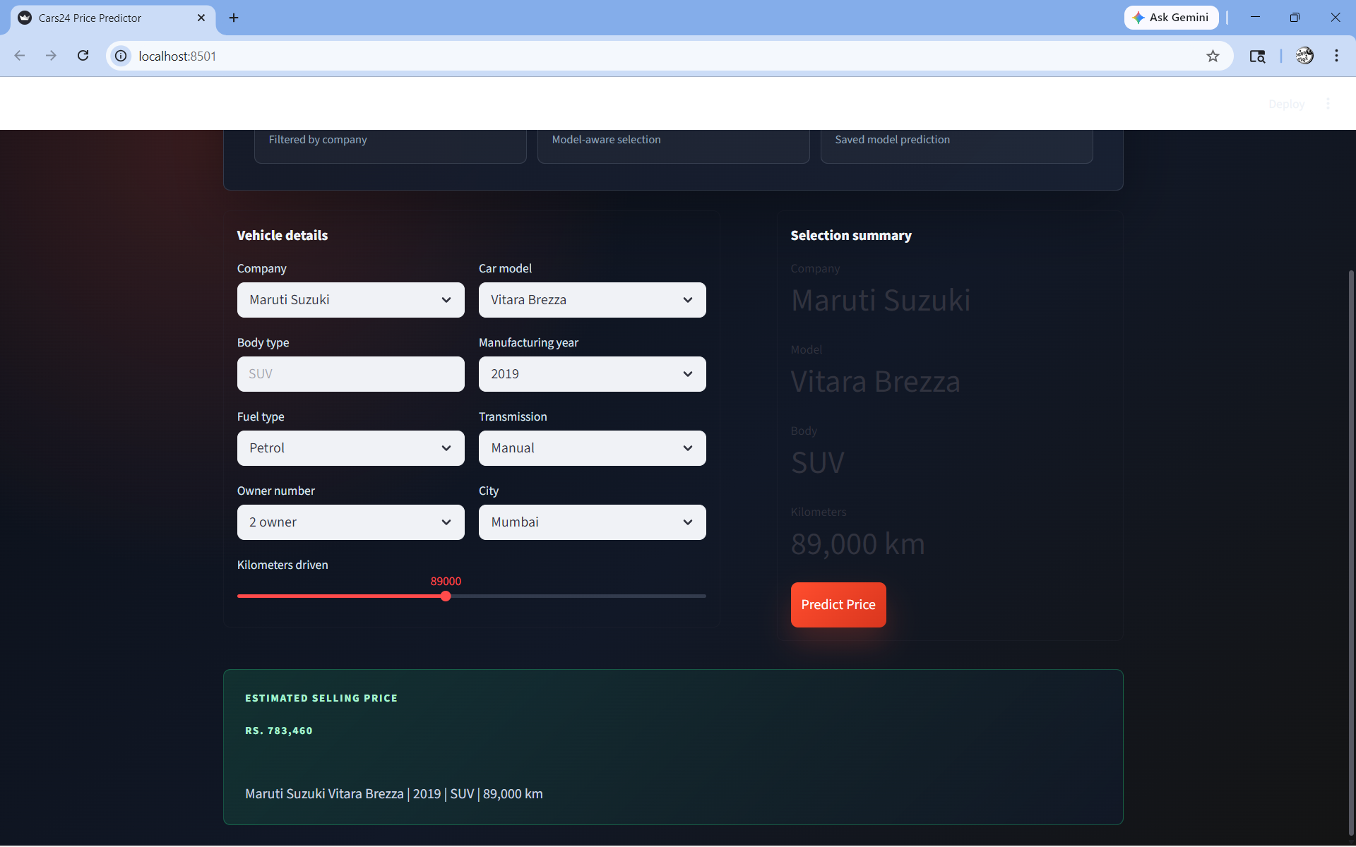
APP RESULT
The prediction output converts the model into a user-facing estimate.
Prediction result
The app displays the estimated selling price with the selected vehicle profile, so the model output is clear for non-technical users.
Example shown: Maruti Suzuki Vitara Brezza, 2019, 89,000 km.
22

Slide 22
CHALLENGES FACED
The biggest challenges were turning messy listings into reliable predictions.
1
Data Quality
2
Skewed Target
3
Outlier Handling
Missing transmission/body-type values and duplicate rows required careful cleaning before modeling.
Used-car prices had a premium tail, so the target needed careful normalization for stable learning.
Luxury cars and extreme mileage cases could distort errors, so conservative IQR treatment was applied.
4
Feature Consistency
5
Real-World Limits
The app input row had to match the saved model columns exactly to avoid prediction mismatch.
Condition, accident history and service records were not available, so some market variation remains unexplained.
Project learning: accuracy improves when data preparation, feature engineering and deployment format are treated as one connected workflow.
23

Slide 23
THANK YOU
Questions?
Cars24 Car Price Prediction
Mentor: Dilawar Basha
24

